Slide 1
Unit 4 - Fractions

Slide 2
Reducing fractions

Slide 3
Reducing fractions
To reduce fractions:
Find the biggest number that goes into both the numerator and denominator
Divide that number into the numerator and denominator.
( if you did not choose the biggest number, you will have to reduce again)

Slide 4
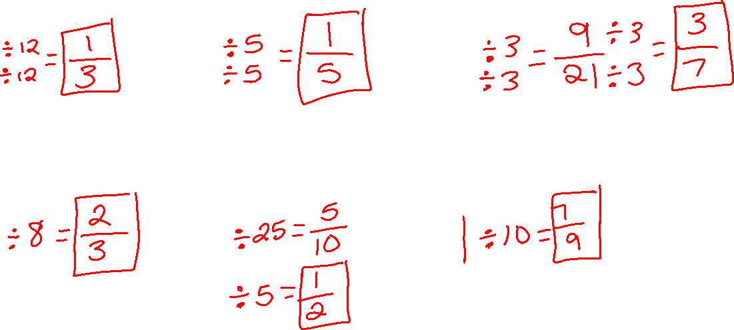
examples
a) $\frac{12}{36}$ b) $\frac{5}{25}$ c) $\frac{27}{63}$
d) $\frac{16}{24}$ e) $\frac{125}{250}$ f) $\frac{70}{90}$

Slide 5
homework
Reducing Fractions

Slide 6
Changing between mixed numbers and improper fractions

Slide 7
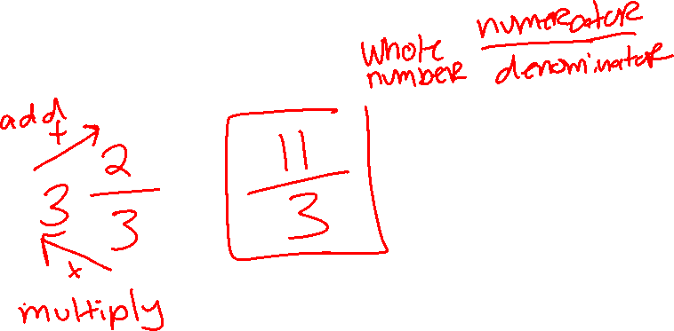
mixed numbers to improper fractions
Multiply the denominator to the whole number then add numerator.
Put that number over the old denominator.
Reduce if possible.

Slide 8
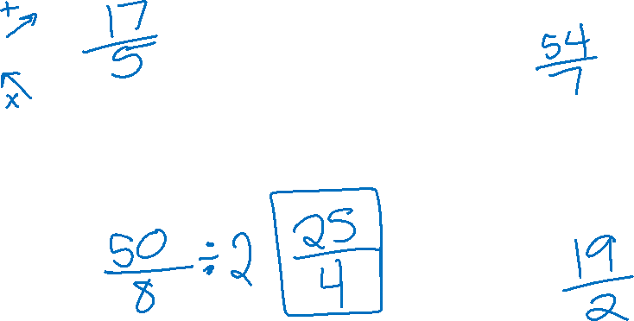
examples
a) 3$\frac{2}{5}$ b) 7$\frac{5}{7}$
c) $6\frac{2}{8}$ d) $9\frac{1}{2}$

Slide 9
improper fraction to a mixed number
Numerator ÷ denominator (write the whole number)
Numerator – (Denominator x whole number) (write as numerator)
Keep old denominator

Slide 10
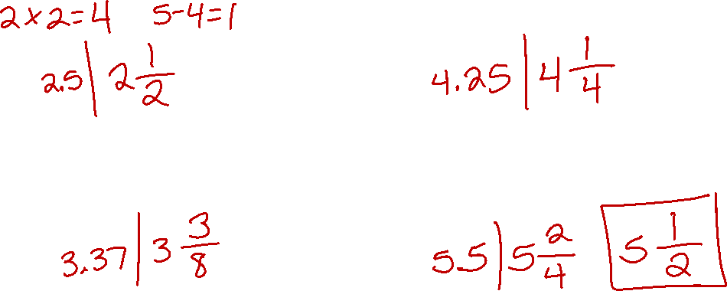
examples
a) $\frac{5}{2}$ b) $\frac{17}{4}$
c) $\frac{27}{8}$ d) $\frac{22}{4}$

Slide 11
Homework
Changing between mixed numbers and improper fractions

Slide 12
Adding and subtracting fractions

Slide 13
Adding and subtracting with common denominators
Add or subtract the numerator.
Keep the denominator.
Reduce if possible.

Slide 14

examples
$\frac{2}{7}$ + $\frac{4}{7}$ $\frac{8}{9}$ - $\frac{5}{9}$
$\frac{9}{10}$ - $\frac{3}{10}$ $\frac{6}{12}$ + $\frac{5}{12}$

Slide 15
Adding and subtracting with different denominators
Find a number that both denominators will go into evenly.
Whatever you do to the bottom number you have to do to the top.
Add or subtract the numerators.
Keep the new denominator.
Reduce if possible.

Slide 16
examples
$\frac{1}{2}$ + $\frac{4}{3}$ $\frac{8}{10}$ + $\frac{3}{5}$ $\frac{5}{9}$ - $\frac{1}{2}$
$\frac{7}{8}$ - $\frac{2}{3}$ $\frac{17}{24}$ - $\frac{4}{6}$ $\frac{4}{6}$ + $\frac{1}{4}$

Slide 17
homework
Adding and Subtracting Fractions worksheet.

Slide 18
Bellwork
**Reminder**
If you are absent, this is where to find notes and the assignment.
http://mswilsonmathnwhs.weebly.com/

Slide 19
Multiplying fractions day 1

Slide 20
objective
Students will be able to multiply fraction.

Slide 21
Multiplying fractions
Multiply straight across. (numerator x numerator and denominator x denominator)
Reduce.

Slide 22
examples
a) $\frac{2}{5}$ x $\frac{5}{6}$ b) $\frac{8}{10}$ x $\frac{3}{5}$ c) $\frac{5}{9}$ x $\frac{1}{2}$
d) $\frac{7}{8}$ x $\frac{2}{3}$ e) $\frac{6}{7}$ x $\frac{4}{6}$ f) $\frac{4}{6}$ x $\frac{3}{4}$

Slide 23
homework
Multiplying Decimals Day 1

Slide 24
bellwork
We move to the potables tomorrow!!

Slide 25
Multiplying fractions day 2

Slide 26
objective
Students will be able to cross cancel then multiply fractions.

Slide 27
Multiplying fractions when you cross cancel
Cross cancel (kind of like reducing diagonally)
Multiply straight across. (numerator x numerator and denominator x denominator)
Reduce.

Slide 28
examples
a) $\frac{2}{5}$ x $\frac{5}{6}$ b) $\frac{8}{10}$ x $\frac{3}{4}$ c) $\frac{5}{9}$ x $\frac{1}{15}$
d) $\frac{7}{8}$ x $\frac{2}{11}$ e) $\frac{6}{12}$ x $\frac{4}{6}$ f) $\frac{4}{6}$ x $\frac{3}{4}$

Slide 29
homework
Multiplying Fractions Day 2

Slide 30
Dividing Decimals

Slide 31
Dividing Decimals
Keep, Change, Flip
Keep the first fraction.
Change the division sign to a multiplication sign.
Flip the second fractions.

Slide 32
examples
a) $\frac{2}{5}$ ÷ $\frac{5}{6}$ b) $\frac{8}{10}$ ÷ $\frac{3}{4}$ c) $\frac{5}{9}$ ÷ $\frac{3}{10}$
d) $\frac{7}{8}$ ÷ $\frac{2}{6}$ e) $\frac{6}{9}$ ÷ $\frac{4}{6}$ f) $\frac{4}{6}$ ÷ $\frac{3}{4}$

Slide 33
homework
Dividing Fractions Worksheet

Slide 34
Equivalent fractions

Slide 35
Equivalent fractions
Equivalent = Same
To solve equivalent fractions:
Cross multiply
Solve for the variable.

Slide 36
examples
a) $\frac{2}{x}$ = $\frac{5}{−6}$ b) $\frac{x}{10}$ = $\frac{3}{4}$ c) $\frac{−5}{−10}$ = $\frac{x}{11}$
d) $\frac{−4}{12}$ = $\frac{3}{x}$ e) $\frac{x}{9}$ = $\frac{−4}{−6}$ f) $\frac{4}{x}$ = $\frac{2}{7}$

Slide 37
Examples
If 5 lb of pasta salad serves 14 people, how much past salad should you bring to a picnic with 49 people?

Slide 38
homework
Equivalent Fractions Day 1

Slide 39
Equivalent fractions day 2

Slide 40
examples
a) $\frac{2}{x}$ = $\frac{5}{−6}$ b) $\frac{x}{10}$ = $\frac{3}{4}$ c) $\frac{−5}{−10}$ = $\frac{x}{11}$
d) $\frac{−4}{12}$ = $\frac{3}{x}$ e) $\frac{x}{9}$ = $\frac{−4}{−6}$ f) $\frac{4}{x}$ = $\frac{2}{7}$

