Slide 1
Unit 3

Slide 2
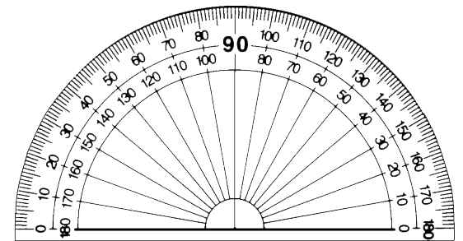
Using a Protractor
Place pivot point on the vertex of the angle.
Align base line along one of the sides.
The other side will point to the angle measure.
base line
pivot point

Slide 3
Classifying Angles
Acute – Less than 90°
Right – Equals 90°
30°
Right Angle Symbol

Slide 4
Classifying Angles
Obtuse – More than 90° but less than 180°
Straight – Equals 180°
135°

Slide 5
Triangle Sum Theorem
The sum of the interior angles of a triangle always equal 180°
x+y+z = 180°
x°
y°
z°

Slide 6
Linear Pair
Two adjacent angles form a linear pair if they form a straight angle.
1
2

Slide 7
Vertical Angles
Two angles are vertical angles if their sides form 2 pairs of opposite rays.
**Basically, vertical angles form an X.
1
2

Slide 8
Angle Types
Interior Angles - angles on the inside
Exterior Angles - angles formed by extending one side of the triangle
exterior
interior

Slide 9
Exterior Angle Theorem
An exterior angle of a triangle is equal to the sum of the two non-adjacent angles
x°
x+y = w
y°
z°
w°

Slide 10
Right Triangle
In a right triangle, the two acute angles are ALWAYS complementary
x + y = 90°
x
y

Slide 11
Example
Find the value of x
x°
x + x + 10 + 78 = 180
(x + 10)°
78°

Slide 12
Example
Find the value of x
2x°
2x + 58 = 126
58°
126°

Slide 13
Perimeter and Area

Slide 14
Perimeter and Circumference
Perimeter: distance around a shape

Slide 15
Examples
Together On Your Own

Slide 16
Section 10-1
Area of Parallelograms and Triangles

Slide 17
Area of Rectangles and Squares
Rectangle Square
A=bh A=bh

Slide 18
Area of Rectangles and Squares
Example
On Your Own

Slide 19
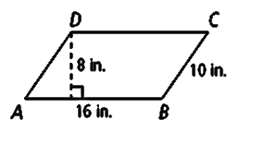
Area of a Parallelograms
Parallelogram
A=bh

Slide 20
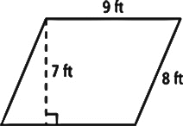
Area of a Parallelograms
Example
On Your Own

Slide 21
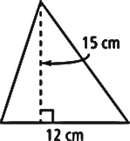
Area of Triangles
Triangle
A=½bh

Slide 22
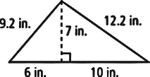
Area of Triangles
Example
On Your Own

Slide 23
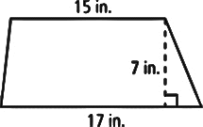
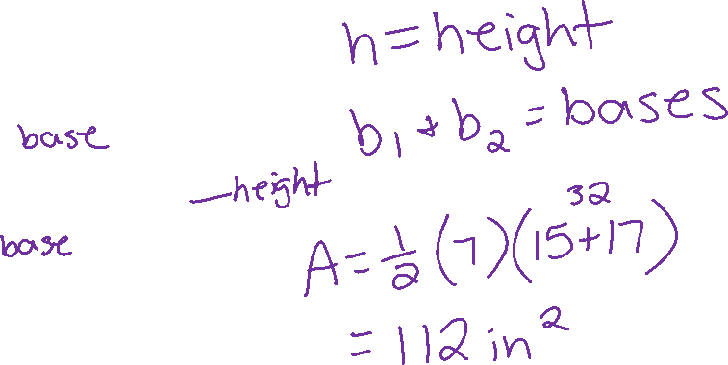
Area of a Trapezoid
A = ½h(b₁+b₂)

Slide 24
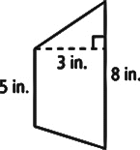
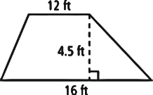
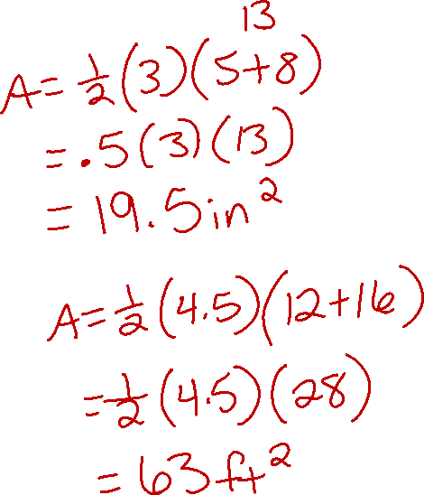
Area of a Trapezoid
Example
On Your Own

Slide 25
Area and Circumference
Circumference: distance around a circle.
Radius: distance from the center to the side.
Diameter: distance across the circle through the center.

Slide 26
Area and Circumference
Circumference:
Area:

Slide 27
Examples
r =
d =
C =
A =

Slide 28
Area of a Regular Polygon
A = ½ap

Slide 29
Area of a Regular Polygon
Example
On Your Own

