Slide 1
Chapter 3
Parallel and Perpendicular Lines

Slide 2
Section 3-1
Lines and Angles

Slide 3
Parallel Lines
Parallel lines - lines in the same plane that do not intersect

Slide 4
Parallel Lines
Little triangles on lines show that they are parallel
Cannot ASSUME lines are parallel

Slide 5
Skew Lines
Skew Lines - lines that do not intersect that are NOT in the same plane
Travel in different directions
One higher than the other
The thick line is above the thin line

Slide 6
Perpendicular lines
Perpendicular lines - lines in the same plane that intersect at a 90° angle
Cannot ASSUME lines are perpendicular
Need “little box” or ⊥

Slide 7
Transversal
a line that intersects two or more coplanar lines at different points
The red line is the transversal

Slide 8
Parallel planes
Parallel planes - planes that do not intersect
The blue plane is above the tan plane

Slide 9
Interior vs. Exterior
Exterior (outside of two lines)
Interior (inside of two lines)
Exterior (outside of two lines)

Slide 10
Same Side vs. Alternate
Same side of transversal
Alternate (opposite sides of transversal)

Slide 11
Types of Angles
Alternate Interior Angles
Alternate sides of transversal
On the interior
A
B
B
A

Slide 12
Types of Angles
Alternate Exterior Angles
Alternate sides of transversal
On the exterior
C
D
D
C

Slide 13
Types of Angles
Same-Side Interior Angles
Same side of transversal
On the interior
E
F
E
F

Slide 14
Types of Angles
Corresponding Angles
Angles in similar spots (same corner, different intersection)
Same side of transversal
One interior & one exterior
K
J
G
H
J
K
G
H

Slide 15
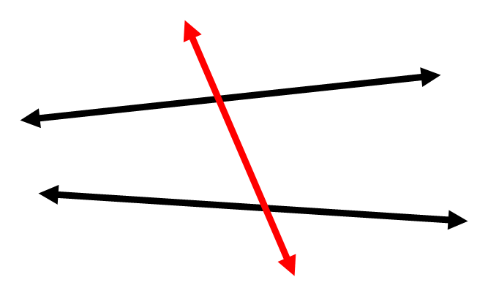
Example
Name the angle relationship.

Slide 16
Example
Name the angle relationship.

Slide 17
Example
Name the angle relationship.

Slide 18
Example
Name the angle relationship.

Slide 19
Section 3-2
Properties of Parallel Lines

Slide 20
Corresponding Angle Postulate
If 2 parallel lines are cut by a transversal, …
then corresponding angles are ≅
4 pairs of equal angles

Slide 21
Alternate Interior Angle Theorem
If 2 parallel lines are cut by a transversal, …
then alternate interior angles are ≅
2 pairs of equal angles

Slide 22
Alternate Exterior Angle Theorem
If 2 parallel lines are cut by a transversal, …
then alternate exterior angles are ≅
2 pairs of equal angles

Slide 23
Same-Side Interior Angle Theorem
If 2 parallel lines are cut by a transversal, …
then same-side interior angles are supplementary
2 pairs of angles add up to 180°

Slide 24
Example Find the values of x and y
106°
x°
y°

Slide 25
Example Find the values of x and y
x°
93°
y°

Slide 26
Perpendicular Transversal Theorem
If a transversal is ⊥ to one of 2 parallel lines, then it is ⊥ to the other

Slide 27
Example Find the value of x
137°
3x + 2 = 137
(3x+2)°

Slide 28
Example Find the value of x
2x + 2x + 16 = 180
2x°
(2x+16)°

Slide 29
Section 3-3
Proving Lines are Parallel

Slide 30
Symbols
The symbol of parallel is ||

Slide 31
Corresponding Angle Converse Postulate
If 2 lines are cut by a transversal and
corresponding angles are ≅
then the lines are parallel

Slide 32
Alternate Interior Angle Converse Theorem
If 2 lines are cut by a transversal and
alternate interior angles are ≅
then the lines are parallel

Slide 33
Alternate Exterior Angle Converse Theorem
If 2 lines are cut by a transversal and
alternate exterior angles are ≅
then the lines are parallel

Slide 34
Same-Side Interior Angle Converse Theorem
If 2 lines are cut by a transversal and
same-side interior angles are supplementary
1
m∠1 + m∠2 = 180°
2
then the lines are parallel

Slide 35
Is it possible to prove m // n?
If so, why?
m
75°
105°
n

Slide 36
Is it possible to prove m // n?
If so, why?
105°
m
105°
n

Slide 37
Section 3-4
Parallel and Perpendicular Lines

Slide 38
Review
In order to prove two lines parallel, you need…
Corresponding angles congruent OR
Alternate interior angles congruent OR
Alternate exterior angles congruent OR
Consecutive interior angles supplementary

Slide 39
Three Parallel Line Theorem
If two lines are parallel to the same line, then they are parallel to each other
m
m || n and n || p → m || p
n
p

Slide 40
Perpendicular to Parallel Theorem
In a plane, if two lines are ⊥ to the same line,
then the lines are parallel to each other.
m ⊥ n and n ⊥ p →
m || p
m
p
n

Slide 41
Section 3-7
Equations of Lines in the Coordinate Plane

Slide 42
Finding slope on a graph
rise
run
slope =
rise = number of units up or down
run = number of units right or left

Slide 43
example
Find the slope between the two points
slope =
-5
3

Slide 44
Slope Formula
Finding the slope of a line passing through a pair of points.
$m= \frac{y₂− y₁ }{x₂−x₁}$
m = slope

Slide 45
Slope-intercept form of a line
A line can be written in the form
y = mx + b
m = slope
b = y-intercept

Slide 46
Section 3-8
Slope & Perpendicular Lines

Slide 47
Are two lines parallel?
Lines are parallel if and only if they have the same slope

Slide 48
Write the equation of a line with the given information
slope = 4 & y-intercept = -2
y = 4x + -2
parallel to y = -¾ x + 6 & y-intercept = 3
y = -¾ x + 3

Slide 49
Are two lines perpendicular?
Two lines are perpendicular if and only if the product of their slopes is -1
m₁ ● m₂ = -1

Slide 50
The slopes of two lines are given. Are the lines perpendicular?
m₁ = 4, m₂ = -¹/₄
m₁ = -⁵/₇, m₂ = -⁷/₅

Slide 51
Another way to think about it
The slopes of ⊥ lines are negative reciprocals of each other.
Ex. j ⊥ k. The slope of line j is ³/₄. What is the slope of line k?

