Slide 1
Chapter 3
Parallel and Perpendicular Lines

Slide 2
Section 3-1
Lines and Angles

Slide 3
Parallel Lines
Parallel lines - lines in the same plane that do not intersect

Slide 4
Parallel Lines
Little triangles on lines show that they are parallel
Cannot ASSUME lines are parallel

Slide 5
Skew Lines
Skew Lines - lines that do not intersect that are NOT in the same plane
Travel in different directions
One higher than the other
The thick line is above the thin line

Slide 6
Perpendicular lines
Perpendicular lines - lines in the same plane that intersect at a 90° angle
Cannot ASSUME lines are perpendicular
Need “little box” or ⊥

Slide 7
Transversal
a line that intersects two or more coplanar lines at different points
The red line is the transversal

Slide 8
Parallel planes
Parallel planes - planes that do not intersect
The blue plane is above the tan plane

Slide 9
Interior vs. Exterior
Exterior (outside of two lines)
Interior (inside of two lines)
Exterior (outside of two lines)

Slide 10
Same Side vs. Alternate
Same side of transversal
Alternate (opposite sides of transversal)

Slide 11
Types of Angles
Alternate Interior Angles
Alternate sides of transversal
On the interior
A
B
B
A

Slide 12
Types of Angles
Alternate Exterior Angles
Alternate sides of transversal
On the exterior
C
D
D
C

Slide 13
Types of Angles
Same-Side Interior Angles
Same side of transversal
On the interior
E
F
E
F

Slide 14
Types of Angles
Corresponding Angles
Angles in similar spots (same corner, different intersection)
Same side of transversal
One interior & one exterior
K
J
G
H
J
K
G
H

Slide 15
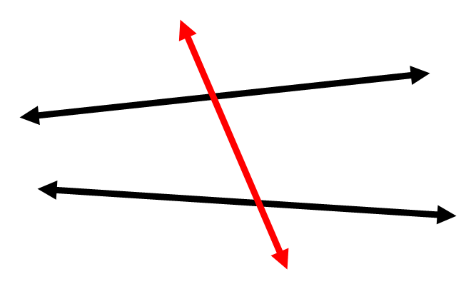
Example
Name the angle relationship.

Slide 16
Example
Name the angle relationship.

Slide 17
Example
Name the angle relationship.

Slide 18
Example
Name the angle relationship.

Slide 19
Homework
Page 144
12-42 even

Slide 20
Section 3-2
Properties of Parallel Lines

Slide 21
Corresponding Angle Postulate
If 2 parallel lines are cut by a transversal, …
then corresponding angles are ≅
4 pairs of equal angles

Slide 22
Alternate Interior Angle Theorem
If 2 parallel lines are cut by a transversal, …
then alternate interior angles are ≅
2 pairs of equal angles

Slide 23
Alternate Exterior Angle Theorem
If 2 parallel lines are cut by a transversal, …
then alternate exterior angles are ≅
2 pairs of equal angles

Slide 24
Same-Side Interior Angle Theorem
If 2 parallel lines are cut by a transversal, …
then same-side interior angles are supplementary
2 pairs of angles add up to 180°

Slide 25
Example Find the values of x and y
106°
x°
y°

Slide 26
Example Find the values of x and y
x°
93°
y°

Slide 27
Perpendicular Transversal Theorem
If a transversal is ⊥ to one of 2 parallel lines, then it is ⊥ to the other

Slide 28
Example Find the value of x
137°
3x + 2 = 137
(3x+2)°

Slide 29
Example Find the value of x
2x + 2x + 16 = 180
2x°
(2x+16)°

Slide 30
Homework
Page 153
7-22

Slide 31
Section 3-3
Proving Lines are Parallel

Slide 32
Symbols
The symbol of parallel is ||

Slide 33
Corresponding Angle Converse Postulate
If 2 lines are cut by a transversal and
corresponding angles are ≅
then the lines are parallel

Slide 34
Alternate Interior Angle Converse Theorem
If 2 lines are cut by a transversal and
alternate interior angles are ≅
then the lines are parallel

Slide 35
Alternate Exterior Angle Converse Theorem
If 2 lines are cut by a transversal and
alternate exterior angles are ≅
then the lines are parallel

Slide 36
Same-Side Interior Angle Converse Theorem
If 2 lines are cut by a transversal and
same-side interior angles are supplementary
1
m∠1 + m∠2 = 180°
2
then the lines are parallel

Slide 37
Is it possible to prove m // n?
If so, why?
m
75°
105°
n

Slide 38
Is it possible to prove m // n?
If so, why?
105°
m
105°
n

Slide 39
Homework
Page 160
8-26 even

Slide 40
Section 3-4
Parallel and Perpendicular Lines

Slide 41
Three Parallel Line Theorem
If two lines are parallel to the same line, then they are parallel to each other
m
m || n and n || p → m || p
n
p

Slide 42
Perpendicular to Parallel Theorem
In a plane, if two lines are ⊥ to the same line,
then the lines are parallel to each other.
m ⊥ n and n ⊥ p →
m || p
m
p
n

Slide 43
Section 3-5
Parallel Lines and Triangles

Slide 44
Triangle Sum Theorem
The sum of the interior angles of a triangle always equal 180°
x+y+z = 180°
x°
y°
z°

Slide 45
Angle Types
Interior Angles - angles on the inside
Exterior Angles - angles formed by extending one side of the triangle
exterior
interior

Slide 46
Exterior Angle Theorem
An exterior angle of a triangle is equal to the sum of the two non-adjacent angles
x°
x+y = w
y°
z°
w°

Slide 47
Right Triangle
In a right triangle, the two acute angles are ALWAYS complementary
x + y = 90°
x
y

Slide 48
Example
Find the value of x
x°
x + x + 10 + 78 = 180
(x + 10)°
78°

Slide 49
Example
Find the value of x
2x°
2x + 58 = 126
58°
126°

Slide 50
Homework
Page 175
1-31 odd

Slide 51
Section 3-7
Equations of Lines in the Coordinate Plane

Slide 52
Finding slope on a graph
rise
run
slope =
rise = number of units up or down
run = number of units right or left

Slide 53
example
Find the slope between the two points
slope =
-5
3

Slide 54
Slope Formula
Finding the slope of a line passing through a pair of points.
$m= \frac{y₂− y₁ }{x₂−x₁}$
m = slope

Slide 55
Slope-intercept form of a line
A line can be written in the form
y = mx + b
m = slope
b = y-intercept

Slide 56
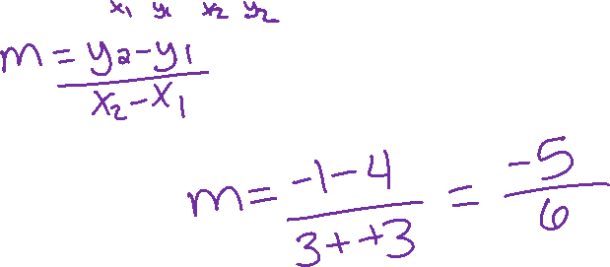
Example
Find the slope passing through the given points. (-3,4)(3,-1)

Slide 57
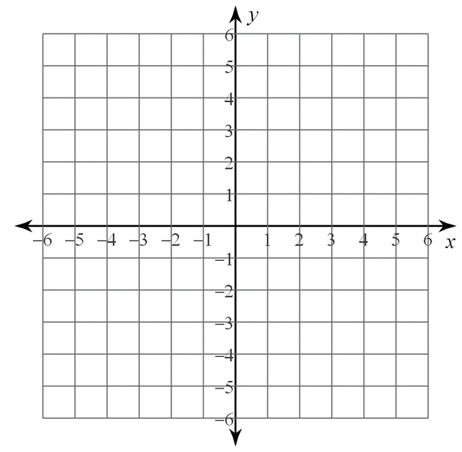
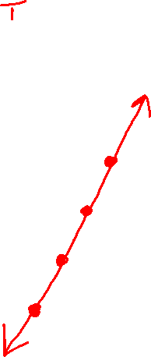
Example
Graph the line. y = 2x - 5

Slide 58
Example
Graph the following.
x = 5 y = -3

Slide 59
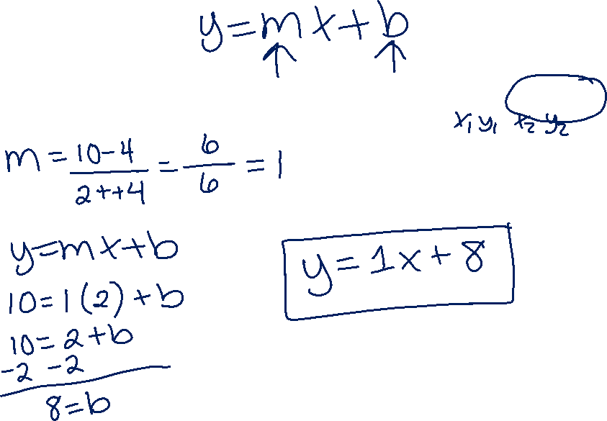
Example
Write the equation of a line given: (-4,4)(2,10)

Slide 60
Homework
Page 194
8, 10, 16, 18, 22, 24, 26, 28, 38, 39, 44, 46, 49

Slide 61
Section 3-8
Slope & Perpendicular Lines

Slide 62
Are two lines parallel?
Lines are parallel if and only if they have the same slope

Slide 63
Write the equation of a line with the given information
slope = 4 & y-intercept = -2
y = 4x + -2
parallel to y = -¾ x + 6 & y-intercept = 3
y = -¾ x + 3

Slide 64
Are two lines perpendicular?
Two lines are perpendicular if and only if the product of their slopes is -1
m₁ ● m₂ = -1

Slide 65
The slopes of two lines are given. Are the lines perpendicular?
m₁ = 4, m₂ = -¹/₄
m₁ = -⁵/₇, m₂ = -⁷/₅

Slide 66
Another way to think about it
The slopes of ⊥ lines are negative reciprocals of each other.
Ex. j ⊥ k. The slope of line j is ³/₄. What is the slope of line k?

